Slide 1

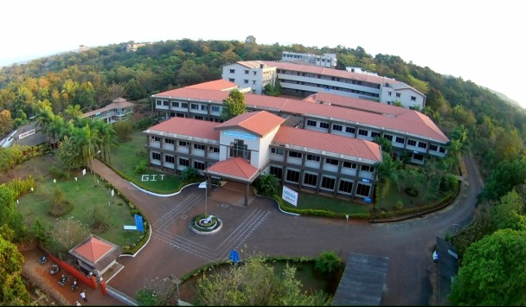

Gharda Institute Of Technology
Open Weather
Presented by
Guided by
Shubham Gundekar(17)
Rutik Khedekar (30)
Omkar Jadhav(21)
Pranal Gotal (16)
Joyti Khalkar Mam
Group No 4
Mini Project
Sem 3
Department of Computer
11-2021

Slide 2
Content
Abstract
Introduction
Theory and fundamentals
Objectives
Methodology
Tools and technologies
Testing / Experimentation
Applications
Conclusion
Future scope
References
Open Weather
11-2021
2

Slide 3
1. Abstract
Weather forecasting is the application to predict the state of the atmosphere for a given location.Here our system will predict weather based on parameters such as temperature, humidity and wind.User will just insert the name of the place where he wanted to know the weather and the user will get the most accurate weather of the geolocation. This system can be used in Daily weather forcasting,Forestry department.
Open Weather
11-2021
3

Slide 4
2. Introduction
The proposed system uses Google API for searching the weather
The proposed system provides the weather of different cities.
Any weather prediction needs a systematic collection of weather record of various places and proper analysis using the data for prediction.
In this system the user can view weather for which they search for.
Open Weather
11-2021
4

Slide 5
3. Theory and fundamentals
In order to create our project we needed an weather information of the location.
We get our API to weather API on Openweather.org so we signup and created account to fetch weather.
We needed an empty directory and name it as index.html to run our website.
We use CSS language for describing the Presentation of the webpage including color,layout,fonts and styling.
To load our webpage with weather information we needed to convert JSON format of information so we use Response.JSON in javascript to convert Json format to an Java object.
Open Weather
11-2021
5

Slide 6
4. Objectives
To deliver the most accurate weather data to the user with the help of information provided by http://openweathermap.org/.
To Plan journey ahead.
Businesses plan for transportation hazards that can result from the weather.
Helps farmers and gardeners plan for crop irrigation and protection (irrigation scheduling, freeze protection etc).
Helps people prepare if they need to take extra gear to prepare for the weather(i.e. umbrella, raincoat, sunscreen)
Open weather
11-2021
6

Slide 7

5. Methodology
We have created our Project in HTML,CSS,JAVASCRIPT.
In this project we have two modules
Information Extraction
Process and Display
Information Extraction : We have colleting our data of the location with http://openweathermap.org/.
Process and Display:We get the weather information in JSON that we display in text format with which is an JAVA Object.
Title of project
11-2021
7

Slide 8
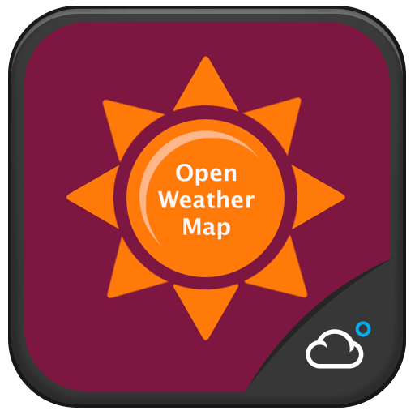
6 Tools and technologies
Most of the web based weather apps are kind of static so to improve the user experince on our page we implimented an dynamic background.
With each reload of page we get the an Geospecific image of the location(like popular festival and speciality of place)
Open Weather
11-2021
8

Slide 9
7. Testing / Experimentation
The API provider that we use in our project is openweathermap.org
The response that we get by this website is in JSON format So to covert json into readable text we use Response.json function in Javascript
To fetch the weather information of the location we use API call function in javascript
The shuffling of the background image of the website we utilize the website https://source.unsplash.com
Open Weather
11-2021
9

Slide 10
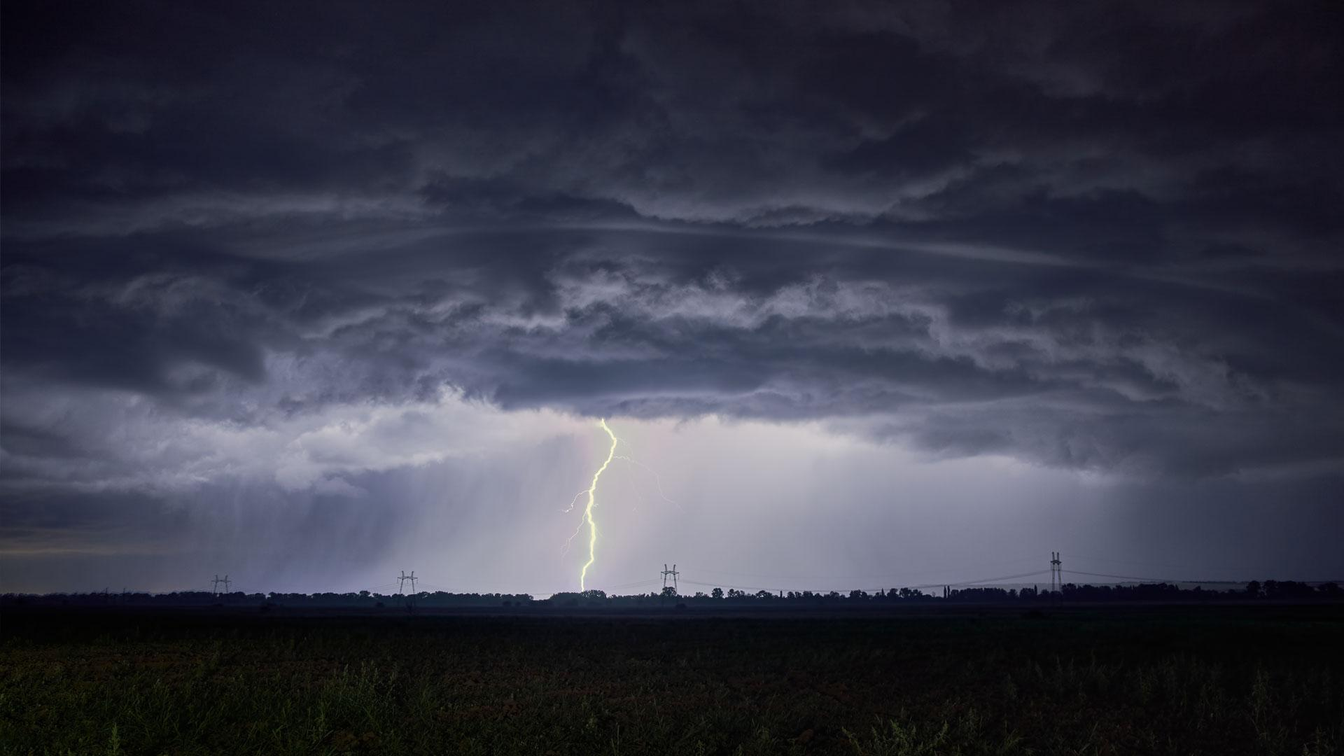
8. Applications
Severe weather alerts and advisories.
Farmers rely on weather forcast to decide what work to do on particular days.
Used by people to prepare if they need to take extra gear to fit for the weather.
Miliatry applications.
Open Weather
11-2021
10

Slide 11
9. Conclusion
With the advancement of technology weather forecasting had developed to its level best, but there is yet to develop, as far as a nature is so unpredictable. Natural calamity and weather disturbances causing devastating destructions surprisingly. To save our mother earth scientist and meteorologist are also advancing their knowledge about weather forecasting.
Open Weather
11-2021
11

Slide 12
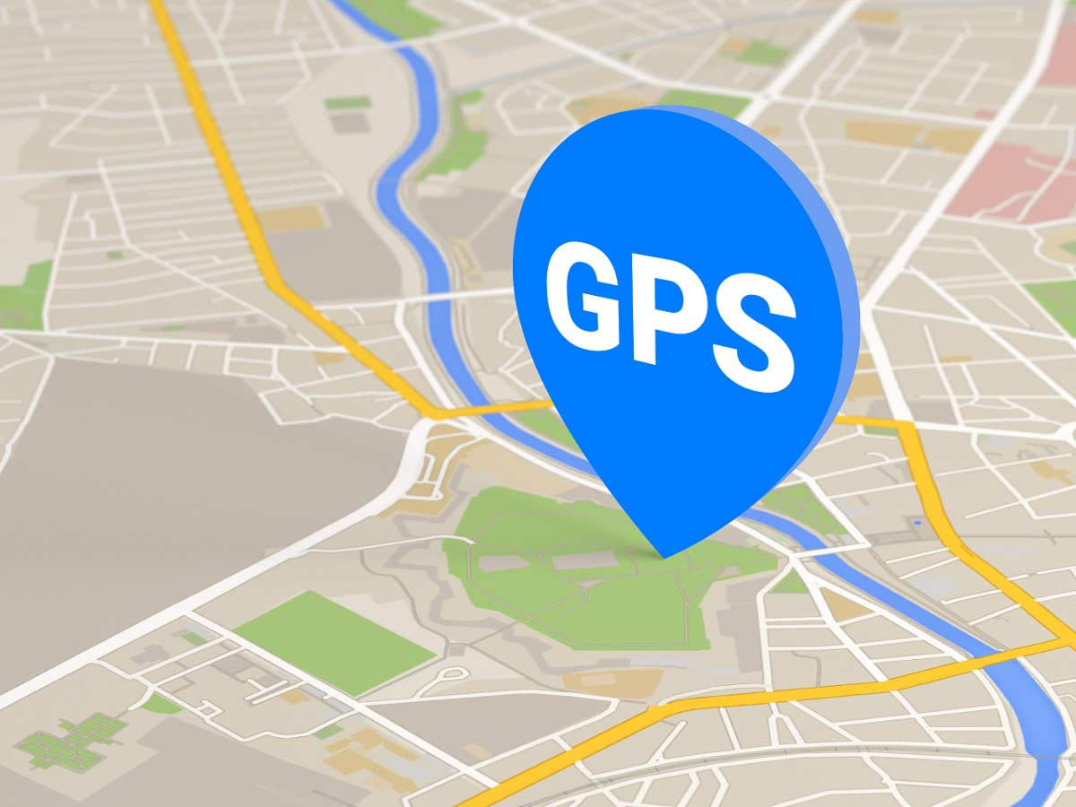
10. Future scope
Our project can be further expanded by adding 7 forecasting days weather information of the place.
This project can also can updated by implementation of location of the user with GPS.
Open Weather
11-2021
12

Slide 13
11. References
Websites:
https://www.geeksforgeeks.org/weather-app-using-vanilla-javascript/
https://www.youtube.com/watch?v=WZNG8UomjSI&feature=you.be
Open Weather
11-2021
13

Slide 14
Output

Slide 15
Output:

Slide 16


